Slide 1
Music and the internet
Group 2
Inga Girshfeld
Katelyn Ogunmowo
Nichole Hawley
Shiva Jafaripour
Sonny Desai

Slide 2
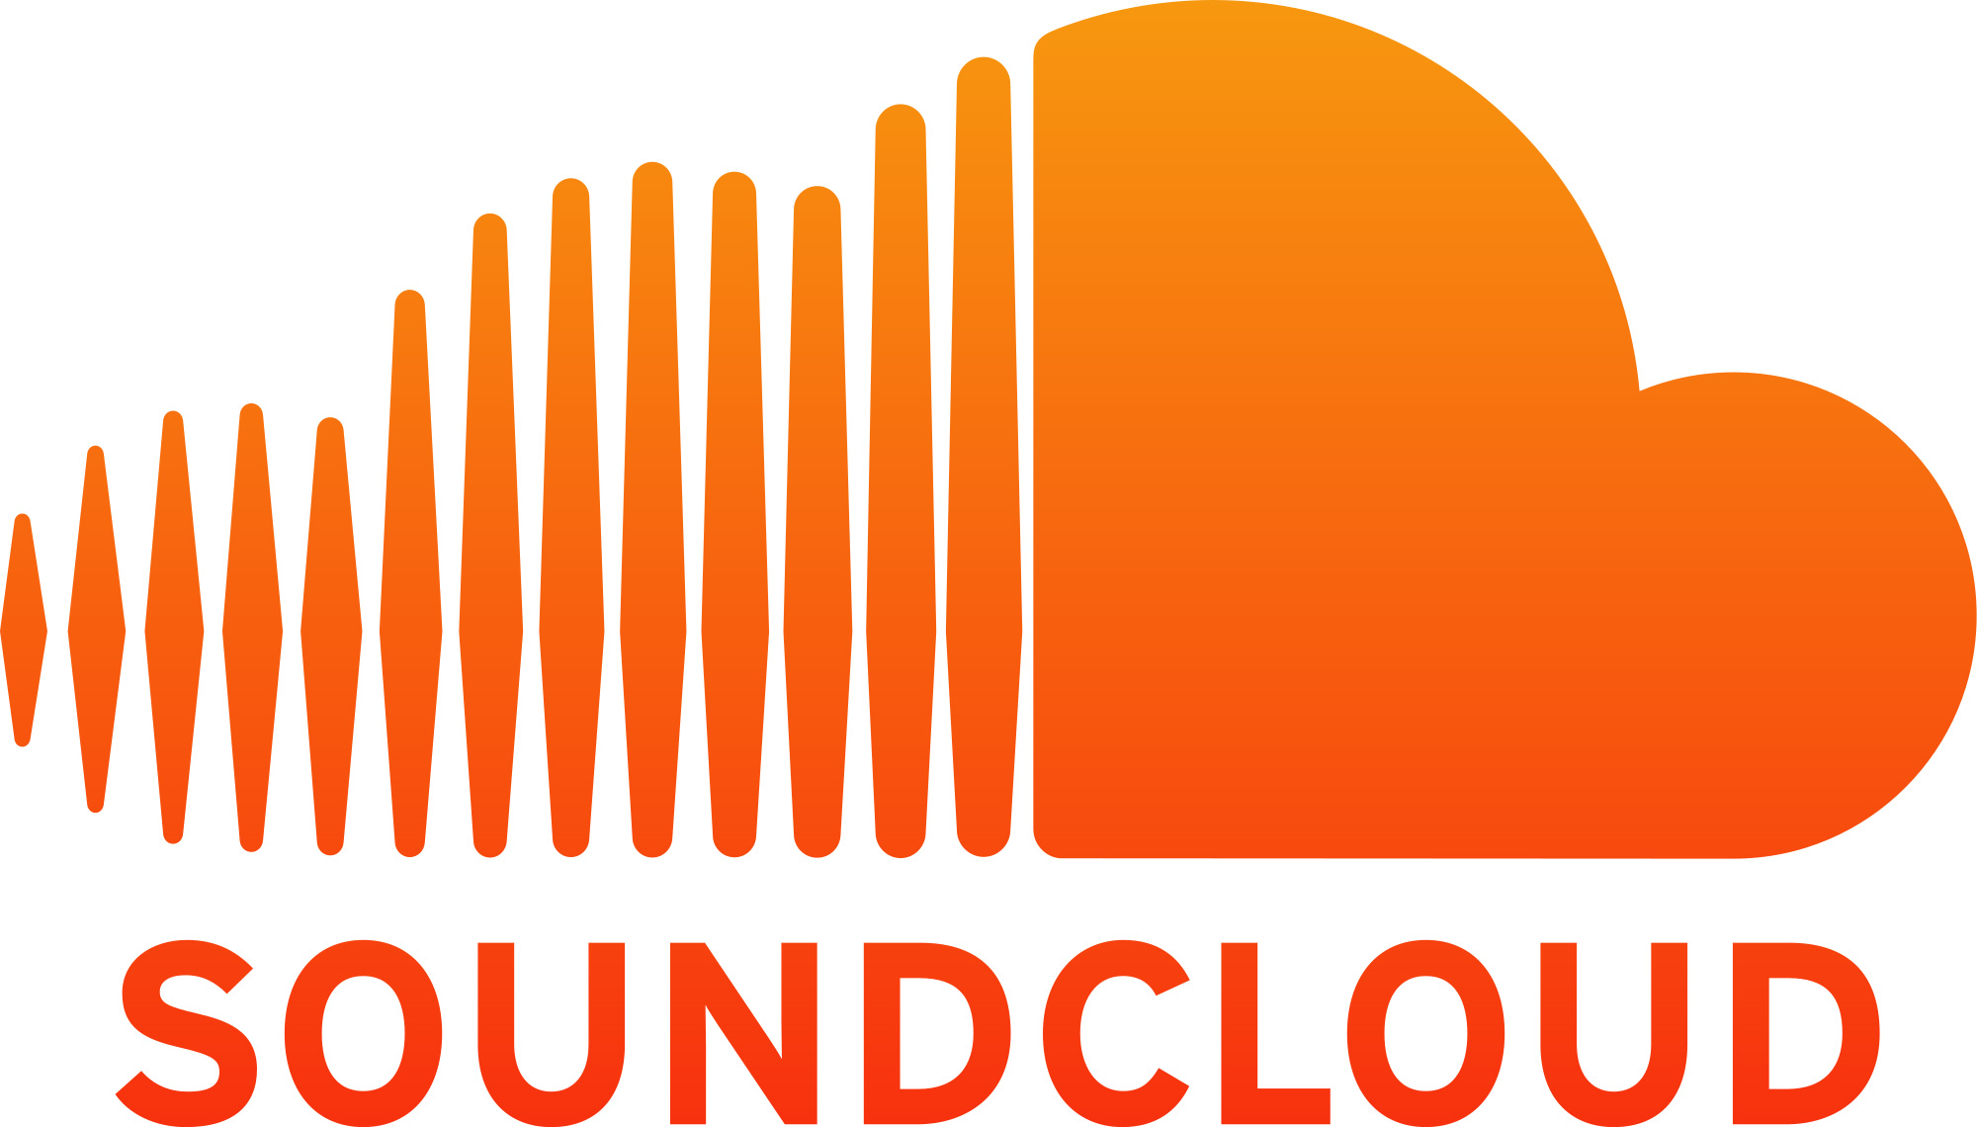
Introduction
10 major music-related events from 1999 to 2015
Some of these sites and apps are still used today, others have been discontinued
Three stakeholders:
Consumers – want to be able to listen to music on demand, but pay as little as possible
Artists – want consumers to listen to their music, but want to receive pay for it
Corporations – want artists to release music to them to provide to consumers, but don’t want to pay a lot for it

Slide 3
Napster – 1999
Peer-to-peer file sharing service that was primarily used for MP3 files (music)
Created by Sean Fanning and Sean Parker and was at the forefront of the music industry around 2000
Connect users with each other to share their own music in their hard drives with one another
Recording Industry Association of America (RIAA) called Napster “a giant online pirate bazaar” and wanted to shut it down
Metallica saw one of their songs on Napster before it was officially released
Metallica along with Dr. Dre sued Napster which was the beginning of their demise
Napster peaked with 26.4 million users worldwide in February 2001
Shut down in July 2001
Acquired by Rhapsody in 2011
Source: Downloaded

Slide 4
Pandora – 2000
Music streaming and automated music recommendation service with approximately 1.5 million songs
While listening, users are offered the ability to buy the songs or albums at various online retailers
Two listening options: free version with advertisements and advertisement-free version for $4.99/month
As of October 2014, less than 5% of listeners were paying for the subscription
Pays three different types of fees to receive its content: SoundExchange, licensing agencies, and Rovi
Pandora is desirable to advertisement agencies because it can reach a more narrow audience
Users have the option of opting out of targeted ads, but they will still receive generic ads
Source: Tech Crunch

Slide 5
LimeWire – 2000
Peer-to-peer file sharing program that allowed users to upload and download many different types of files using BitTorrent
MP3 (music), AVI/MPEG (video), JPG (images)
Free version as well as a purchasable “enhanced” version were available
LimeWire did not use any centralized server to store files
Instead, it directly transfers files from one user’s hard drive to another user’s hard drive
October 26, 2010: U.S. federal court judge issued an injunction forcing LimeWire to stop distributing its software and to disable installed software
The program has been “resurrected” by the creators of WireShare
Source: The Guardian

Slide 6
iTunes – 2001
Began as software to mix your media
Create mixed CDs with your existing music
“Rip. Mix. Burn.”
Soon after, Apple introduced the iPod
Allowed users to convert their CDs to MP3 files
Compacted data → more space for music
Direct response to Napster in April 2003 by introducing iTunes 4 (that included the iTunes Store)
Introduced foreign idea of buying digital copies of music during a time when everyone was pirating or sharing music
Offered $0.99 singles → single culture
Continued to integrate other media and sophisticated platform to lure users
Source: Apple

Slide 7
MySpace – 2002
Anyone, famous or not, could upload their songs onto MySpace and millions of people would have access to listening by adding them as a friend
Artists such as Lily Allen, Owl City, Hollywood Undead, Sean Kingston, Arctic Monkeys, and Drop Dead, Gorgeous were discovered through MySpace
2008 – MySpace redesigned its music page and added new features
Artists could make playlists, songs could also be archived
Suggests songs that are similar to the ones you are listening to with discovery tool
You can view popular music from other countries of the world
Source: CNet

Slide 8
Vuze - 2003
A BitTorrent client used to transfer files via BitTorrent protocol
Fastest BitTorrent client
Content is presented through channels and categories containing TV shows, music videos, movies, video games, and others
Personalized with the subscription feature
Drag and drop feature
Can export media directly to external devices
Integrated with iTunes
If users publish their own original content, they may earn money through it
Users are required to accept restrictive license terms
Source: Softpedia

Slide 9
YouTube – 2005
Video sharing website that allows users to upload, view, share, comment, and “like” videos
When users upload a video, they are shown a message asking them to not violate copyright laws
YouTube does not screen videos before they are posted, leaving copyright holders responsible for reporting copyrighted videos
Users do not have the ability to download videos from YouTube, but individuals find ways around that
Example: YouTube to MP3 converters
Many famous artists have been discovered through YouTube
Cody Simpson, The Weeknd, Austin Mahone, Carly Rae Jepsen
Source: USA Today

Slide 10
Spotify – 2006
Music streaming, podcast, and video service that provides music content from record labels and media companies
Two options: Spotify Free and Spotify Premium
Pays artists based on their “market share”
The number of streams of their songs as a proportion of the total songs streamed on Spotify
70% of the payment goes to the rights-holders, who then compensate the artists based on individual agreements
Has been said to be as low as $0.0011 per stream
In 2014, Taylor Swift removed her music from Spotify
Spotify has claimed that “given a free and legal alternative, people will pirate less”
In Norway, 1.2 billion songs were pirated in 2008 and 210 million were pirated in 2012
Source: The Register

Slide 11
SoundCloud – 2007
Founded by Swedish sound designer Alexander Ljung and artist Eric Wahlforss in Stockholm
Goal was to make a Flickr for EDM musicians
Initially wanted to allow musicians to share recordings with other musicians (not the general public)
Transformed into a global audio distribution platform that allows users to upload and promote their original work
SoundCloud made collecting DJ sets, once a minority pursuit, into something anyone could do (huge contributor to the growth and distribution of EDM)
“YouTube of audio”
Atmosphere for artists to easily interact with fans
A way for semi professional artists to grow their own community, bypassing record labels
Source: The Wall Street Journal

Slide 12
Apple Music – 2015
A music streaming service developed by Apple Inc.
Users can select music to stream to their devices on demand
Allows signed artists and unsigned artists to share photos, videos, posts, and tracks with consumers
Personalized music recommendations
Music can be played offline to work with user’s data plan
Cost
Free trial for up to 3 months
Apple Music agreed to pay the artists during this 3 month free trial after Taylor Swift wrote a public letter refusing to release her music
$9.99/month for individual users
$14.99/month for family subscription (maximum of 6 people)
iCloud family sharing required: users share music, apple purchases, photos, and location
Music industry turned down Apple’s request to charge less for Apple Music
Main difference between Apple Music and iTunes: you don’t own the music
If you turn off Apple Music, the music is gone
Requirement: Apple ID
Source: Apple

Slide 13
Conclusion
Tangible music → digital copies of music → ownership of music antiquated
Centralization of music
Focus on the single rather than the album in entirety
More exposure & easier access for artists
Record labels become less necessary for new artists
YouTube, SoundCloud, and Apple Music launching careers democratically
Problems with compensation for artists via streaming services
Users still prone to pirating music

Slide 14
Works Cited
Downloaded. Dir. Alex Winter. Perf. Henry Rollins and Noel Gallagher. VH1, 2013. Film.
Halliday, Josh. "LimeWire Shut Down by Federal Court.” The Guardian (2010)
Lanxon, Nate. "MySpace Music: Three Major Labels Apply Eyeshadow.” CNet (2008)
Muradin, Alex. "The Torrent Master Is Back." Softpedia (2005)
Orlowski, Andrew. "Spotify, DRM and the Celestial Jukebox." The Register (2009)
Rusli, Evelyn M., Hannah Karp, and Douglas Macmillan. "SoundCloud’s
Valuation Could Top $1.2 Billion With New Fundraising." The Wall Street Journal (2014)
Schonfeld, Eric. "With 80 Million Users, Pandora Files To Go Public." Tech Crunch (2011)
"YouTube Served up 100 Million Videos a Day Online.” USA Today (2006)

