Slide 1
Information Literacy at a (Social) Distance: Strategies for Moving Online
Melissa A. Wong
@LISafterClass
ACRL Webinar - March 17, 2020
https://bit.ly/38XtwxT
Notes:
Good afternoon everyone and thanks for joining us. A few notes as we start. First, these slides are wordy-er than I’d normally like, but I wanted them to stand alone. If you get interrupted during the webinar, you can read the slide to see what you missed. Also, if you want to share the slides with a colleague, they should stand on their own pretty well. Second, the slides and a resource handout are online at the URL on this slide. Once the recording is available, I’ll provide that link as well.
I’m going to leave the chat open during today’s webinar. You are welcome to chat with comments and questions. If I do not get to your question while I’m talking, we’ll have a dedicated Q and A at the end and you can ask it again.

Slide 2
I’m stressed. You’re stressed. We’re all stressed.
Image by SilviaEmilie from Pixabay
Notes:
I want to start with a reality check for all of us. These are stressful times. In addition to providing instructional continuity for our information literacy programs, we are trying to figure out whether our libraries can close, how to support our colleagues and student workers, and how to care for our families. In today’s webinar, I’m going to emphasize simple approaches for moving your instruction online. Remember that high quality, robust online learning requires a lot of planning and design – we don’t have that kind of time right now. Our goal is to provide enough support that students can finish the semester.

Slide 3
Guidelines
Start from where you are.
Keep it simple.
Don’t do more than you can do.
Notes:
I want to suggest a few guidelines as you move your instruction online.
First, start from where you are. Take stock of what you already have – LibGuides, videos, tutorials – and figure out how to repurpose them. You don’t need to create an online information literacy program from scratch.
Second, keep it simple. Not only will this be easier for you, it will be easier for students (for reasons I’ll discuss in a moment).
Third, don’t do more than you can do. If you are an overachieving perfectionist like myself, that’s going to be hard, but this is an opportunity to practice letting go. Give yourself permission to stop at “good enough” and encourage colleagues to do so as well.

Slide 4
Students are stressed, too. They may not care about information literacy right now. That’s okay.
Image by 1388843 from Pixabay
Notes:
Our students also have a lot going on. They are suddenly enrolled in a distance education program they did not sign up for. They may not have the technology they need. Many of them had to leave campus in a hurry, they have lost jobs or are facing reduced income, or are working in jobs that expose them to the public. Like us, they are trying to stock up on food, practice social distancing, and homeschool children.
They may not care about the finer points of information literacy. That’s okay. Focus on teaching them just enough to get through the papers and projects they need to do to finish the semester. If you can condense your hour long information literacy class into a 30 minute crash course on finding articles, that’s great. Recommend three databases, not ten. Emphasize that they can contact you for help when they need it.

Slide 5
Leave no student behind.
Assume students are accessing content on their phone.
Make content accessible for students with disabilities.
Notes:
Another vital point as we pivot online is that we do everything we can to serve *all* our students. Many students do not have computers or laptops and many do not have broadband wireless at home (16% of families do not have internet at home, the numbers are higher for rural communities, and public libraries and coffee shops are closed). Students will be sharing devices with family members and accessing content on their phones. Also, we need to ensure our instruction is accessible for students with disabilities. It is a legal and ethical requirement. I’m going to mention some basics during today’s webinar and I’ve also put a handout with advice on accessibility in the Google folder.

Slide 6
Synchronous or asynchronous?
Notes:
Last week as schools were closing, there was a lot of chatter about moving everything to Zoom or something similar for instructional continuity. I have a lot of experience teaching synchronously and I love it. However, I don’t think it is appropriate for everyone or even necessary at this time. As a first step in moving your information literacy instruction online, you need to decide whether to go synchronous, asynchronous, or a combination of both.

Slide 7
Synchronous Instruction
Advantages
Disadvantages
Use existing lectures
Real-time discussion
Answer student questions
Maintain community
Higher bandwidth
Limited mobile access
Learning curve
Notes:
Synchronous instruction takes place in a platform like Zoom or Collaborate with all of the students online at the same time, like this webinar. Instructors can show slides, lecture, demonstrate databases using desktop sharing, lead a chat discussion, have students speak on the mic, and even break students into small groups for active learning. Synchronous instruction offers a number of advantages: the ability to reuse the lecture and discussion materials you already have planned, the ability to have a real-time discussion or learning activity, and the opportunity to answer student questions, just as you would in a face to face class. Also, being online all together can foster a sense of community and social support that many of us really need right now.
However, synchronous instruction has some disadvantages. First, it requires higher bandwidth; that’s going to be a problem for students who lack strong internet connections or have limited data plans. It may also be harder to access over a smartphone, especially if you expect students to do more than just listen to a lecture. Finally, there’s a learning curve for you – and you may or may not have the time and emotional energy to learn a new platform at this point.

Slide 8
Asynchronous Instruction
Advantages
Disadvantages
Lower bandwidth
More mobile friendly
Students can use anytime
Uses familiar tools
Recycle content
Easy to replicate
Students may not engage
Potential loss of community
Notes:
Asynchronous instruction is a combination of written material and videos or tutorials that students work through at their own pace. An asynchronous lesson can be published in a course management system, as a PDF that you share with students, or on a platform like LibGuides. Asynchronous instruction is less flashy, but has a lot of advantages. It is much lower bandwidth, potentially easier to access on a smart phone, and students can take it whenever they want (this will be important for students who are moving out of housing, dealing with childcare and work disruptions, and the like). You can use the tools you are already familiar with – Word, LibGuides, the screencast software you might already be using; you can recycle content you already have - your existing videos, LibGuides, etc.; and once you make a basic lesson or two, they can be templates to create more lessons. So, it may be quicker and less stressful to create asynchronous lessons, especially in the beginning.
There are a few disadvantages – students may not engage as fully as they will in a live class session and you may not get the sense of community that a live session will give you. But, I think the advantages outweigh those disadvantages, especially if our goal is to keep things manageable.

Slide 9
Which is right for you?
What are your campus requirements?
What is your campus infrastructure?
Who are your students?
How comfortable are you teaching?
How comfortable are you teaching online?
How much energy can you give this?
Notes:
A few things to consider as you choose between asynchronous and synchronous models:
What are your campus requirements – are you expected to go to Zoom or do you have some freedom? What tools are you allowed to use (e.g., what is FERPA compliant)?
What is your campus infrastructure – what LMS are you using and does every course have a site and every student a login? Do you have a campus-wide Zoom license that will be able to handle the traffic? Do you have a help desk that can troubleshoot problems with logging in?
Who are your students? Do they have experience with online education? Do they have the technology and confidence to access something like Zoom? Where are they living? What kind of disruptions are they facing in their personal lives? I’m lucky enough to teach in a program where the majority of students are enrolled in our distance option or have taken an online course, we have a robust instructional technology department and an amazing help desk staff that is able to work from home to support every course. We should be able to pivot online relatively easily, but not everyone has that infrastructure or students who are as well prepared.
Also think about yourself:
How comfortable are you teaching? If you have a lot of experience, you might be comfortable trying something new and going synchronous! If you are new to teaching or have never taught online, you might want to start with asynchronous and move into synchronous options gradually.
How much energy can you give this? Again, be kind to yourself.

Slide 10
A Model for Asynchronous Info Lit Instruction
Determine your learning outcomes.
Plan - what should students read, watch, or do to master the outcomes?
Identify existing resources you can reuse.
Write or create any new resources.
Write step-by-step directions for students to follow (the “lesson”).
Share it with students (e.g., email, PDF in the LMS, LibGuide).
Notes:
Note: There is an example in the Google folder.

Slide 11
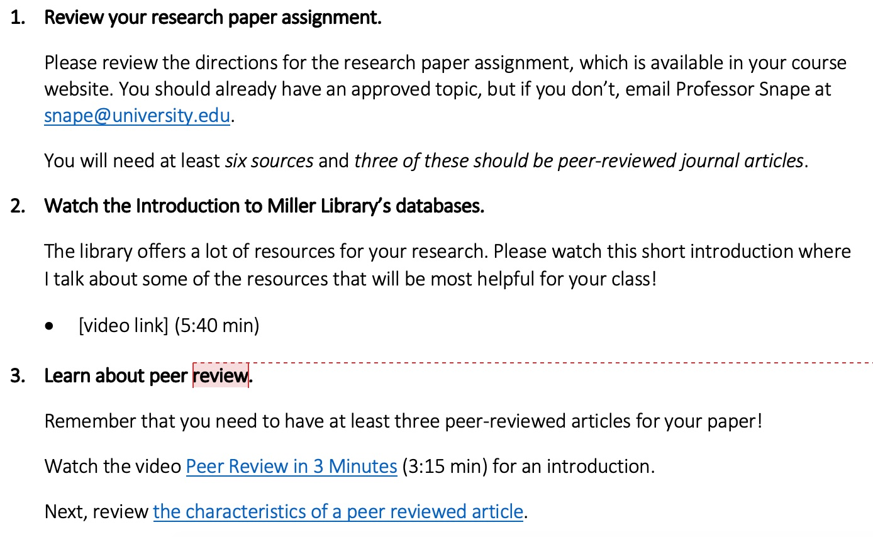

Slide 12
Tips for Going Asynchronous
Have a single lesson and link out to additional content.
Label everything clearly.
Limit content.
Be concise.
Add a human factor.
Ensure accessibility.
Notes:
Have a single lesson – put everything students need to do into one place with step by step directions and all the links they need. Do not make them search for things.
Label everything clearly so there is no confusion that they are in the right place or what a video will contain.
Limit your content and edit your writing for concision. It is easy to overwhelm students in an asynchronous lesson by adding extra resources, but you want to resist that urge, especially at a time when students are already overwhelmed.
Add a human factor that shows there is a person behind the instruction – start your lesson with a welcome and introduction, add your photo, encourage students to contact you, use humor, and do other things to establish a personal connection.
Ensure accessibility – use simple, large fonts; use Styles in Word to indicate the title and subheadings; add alt text for images; avoid using color to signify meaning; caption your videos.

Slide 13
Personal Favorite: Screencast-O-Matic
Videos up to 15 minutes
Screencast, slidecast, and/or webcam
Caption
Upload to Screencast-O-Matic or YouTube
Download to desktop
Notes:
One of my favorite apps for creating asynchronous content is Screencast-O-Matic, which is free software for creating videos. It is easy to use and allows you to caption your content. You can upload finished videos to the Screencast-O-Matic site or a YouTube account or download the file if you plan to host the video on your own library’s server.

Slide 14
Personal Favorites: Skitch & Jing
Notes:
Another favorite strategy for asynchronous instruction is a screenshot, since a picture is worth a thousand words. Both Skitch (for Macs) and Jing (for PC) will allow you to take a quick screenshot and then mark it up with boxes, arrows, etc. Once you have done that editing, save the image and re-use it in lessons, LibGuides, etc.

Slide 15
Tips for Going Synchronous
Provide instructions on how to access the session / tech support.
Use slides.
Arrive early.
Break it up.
Incorporate active learning.
Encourage the use of chat.
Small group work is possible.
Notes:
Let’s talk a little bit about hosting a synchronous instructional session. A few tips to get you started:
Provide clear, written instructions with links on how to access the session and tech support.
Having a set of slides gives students a place to focus their attention. It is also a place for you to provide key vocabulary, activity directions, images, or anything else you would normally put on the whiteboard. If you plan to have a live database demonstration, you might want to create a version with screenshots in your slides as a backup.
Arrive early and chat with students as they arrive to create a welcoming atmosphere.
Break it up - remember that it is really hard to listen to an hour-long online lecture without getting distracted. Break content into 10-15 minute chunks interspersed with interaction like a chat discussion, a poll, reflective writing, or an online searching activity. If class is longer than an hour, take a break, just like you would in a face-to-face class.
Encourage students to use the chat to ask questions or make comments as you lecture. It promotes engagement and metacognition and you can pause to clarify before you go too far past whatever was unclear, interesting, etc. It may feel overwhelming at first but you’ll adjust.
Small group work - most software options allow you to break into small groups for discussion, case studies, etc. Provide clear, written directions (e.g., as a PDF you push to students) and set a timer so students know how long they have to work. If you want students to take notes and report back, it can be helpful to set up a shared Google Doc for the entire class. I give every group its own page and repeat the activity directions there for easy reference. You can also do collaborate brainstorming or notetaking in a Google Doc.

Slide 16
A Model for Synchronous Info Lit Instruction
Welcome/Introduction [5 min]
Discussion – What can I help you learn? [5 min]
Lecture / Poll Activity on Boolean Searching [15 min]
Desktop Sharing – Demonstrate a Database [10 min]
Lecture / Activity on Subject Headings [10 min]
Q and A [5 min]
Notes:
Here’s an example of an outline for a synchronous session. It starts with a few minutes to welcome students and introduce yourself, then we have a chat-based discussion. I can also invite a few students to raise their hands and speak on the mic. Then I have a short lecture on Boolean searching, followed by a practice activity where students answer via a poll. Next, I use screensharing to demonstrate database searching, asking students to follow along on their own computers. Then we go back to the slides for a short lecture on subject headings and have students conduct another practice search. Finally, we end with time for any questions that haven’t already been answered.
One additional tip – assume everything will take a bit longer than it did in a face-to-face classroom. Again, try not to plan too much, especially in the beginning.

Slide 17
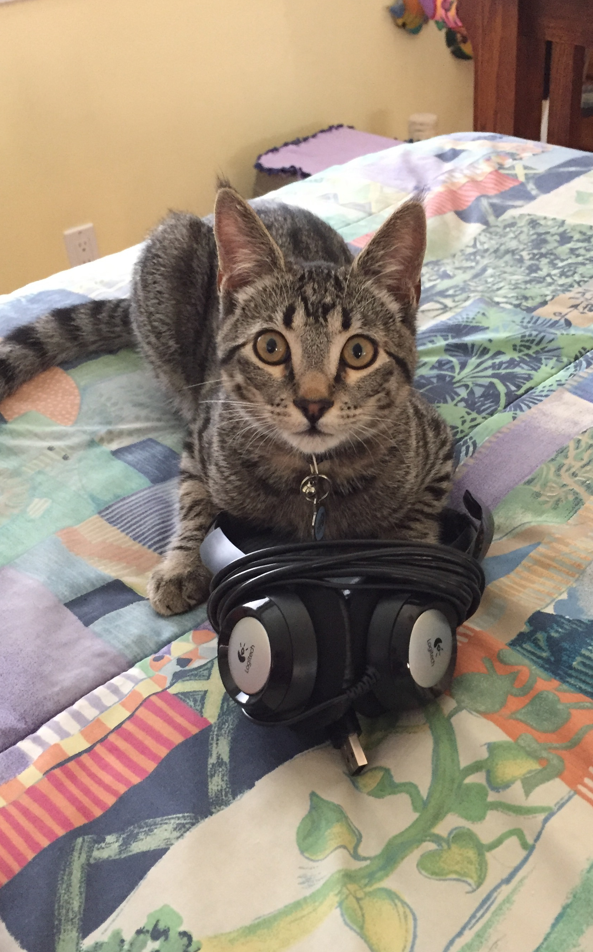
Bonus Tips!
Go audio only.
Use a headset mic.
Notes:
Audio only uses less bandwidth than audio with video, so consider skipping the video unless it is necessary for something you are teaching.
You will have better quality sound if you use a headset mic.

Slide 18
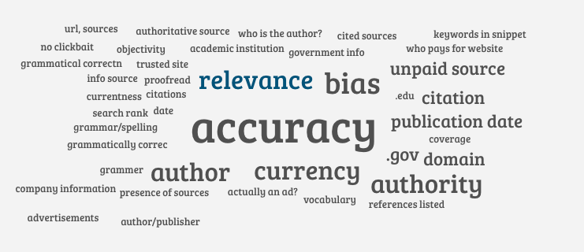
Personal Favorite: AnswerGarden
Notes:
One of my favorite tools for synchronous sessions is AnswerGarden, a really simple site that allows you to poll students and turn the answers into a word cloud in real-time. It is a great way to brainstorm. I also use it as a discussion starter.

Slide 19
Try AnswerGarden
1. Go to https://answergarden.ch/1148810
2. Enter a one-word answer:
How do you feel about moving your instruction online?
3. Answer again with a new word (optional).
4. Refresh your screen to see the word cloud emerge.

Slide 20
Q and A

Slide 21
Final thoughts
Start from where you are.
Do what you can.
Be human first.
You can do hard things!
Notes:
As we wrap up, I want to share a few final thoughts.
-First, a reminder to start from where you are. Take stock of what you already have and repurpose what you can, rather than building an online program from scratch. Remember that you can scale up over time. Responding to coronavirus isn’t a sprint – it’s going to be a marathon.
-Do what you can. We all have a lot of responsibilities and we are all pretty stressed. Things change daily. Have modest expectations for yourself and accept “good enough.”
-Be human first. The most important thing you can do is connect with students, show them that you care, and be there when they need help. A human connection is more important than a flashy tutorial.
-Finally, we are going to have good days and bad days, but we can do hard things!

Slide 22
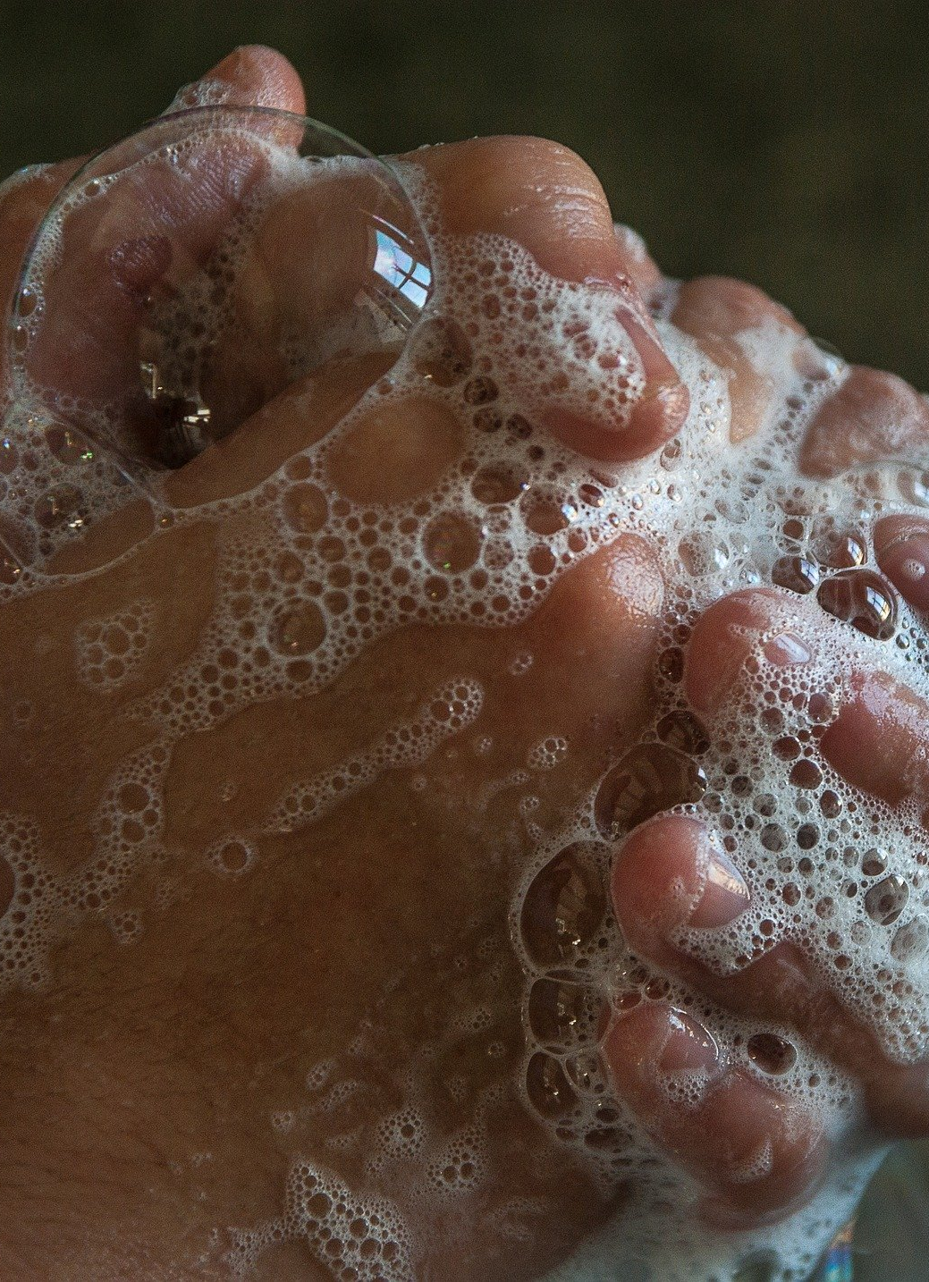
Thank you and good luck!
Image jacqueline macou, Pixabay

